Slide 1
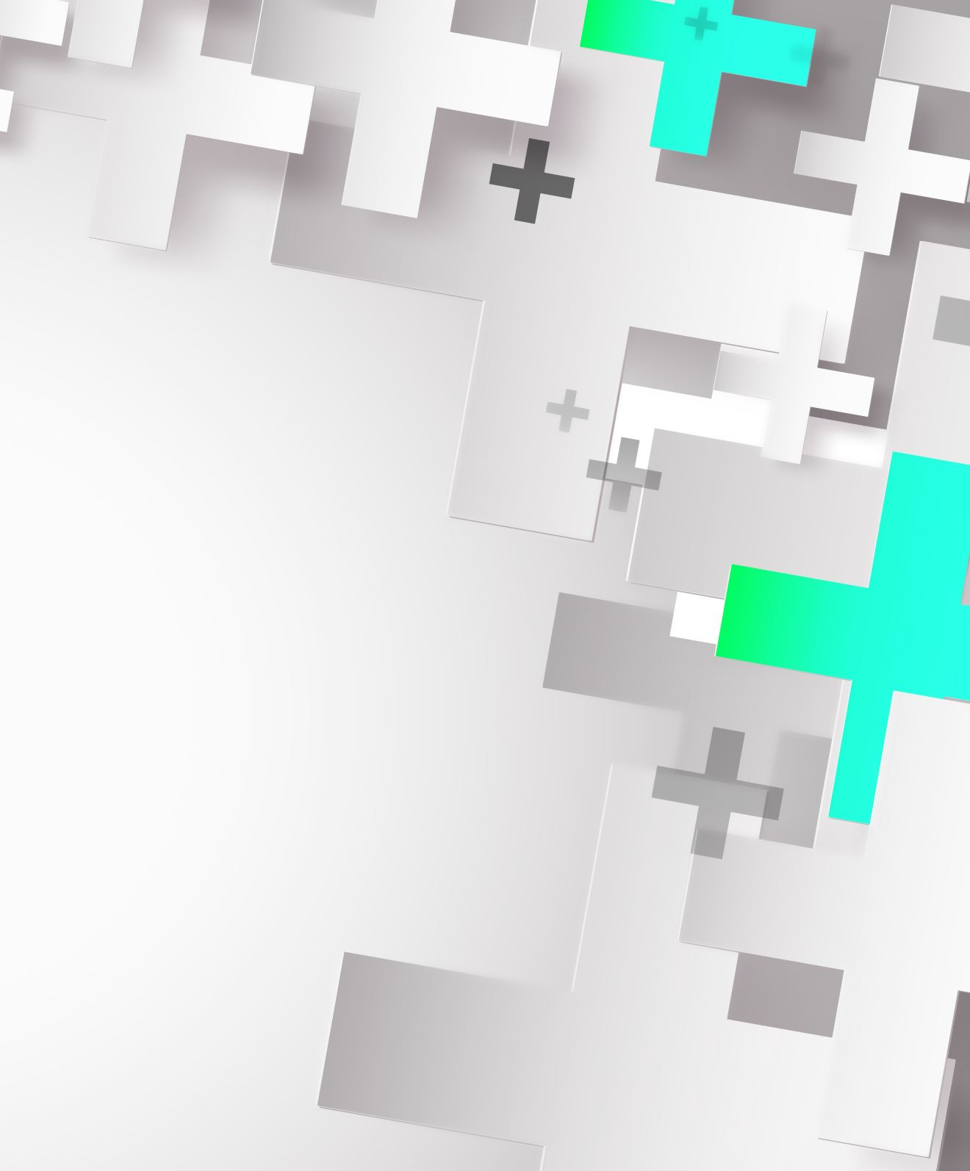
Improving Robustness of Deepfake Detectors through Gradient Regularization
Student: Caminiti Andrea 1924053
Teacher: Irene Amerini
TAs: Lorenzo Cirillo
Claudio Schiavella
Course: Computer Vision
MSc. in Artificial Inteligence and Robotics

Slide 2
Outline
Introduction
Related Works
Proposed method
Datasets and Metrics
Implementation details
Experimental results
Conclusion and Future Works
References

Slide 3
Introduction
the continuos improvement seen in generative artificial intelligence has highlighted the need to have efficient and reliable DeepFake Detectors (DFD).
Indeed DFDs are been used more and more in high stakes cases, such as journalism, court evidence verification, identity protection and many more.
Thus we need systems that work independently from the types of forgeries seen in training and even more importantly they should be robust to adversarial attacks

Slide 4
Outline
Introduction
Related Works
Proposed methods
Datasets and Metrics
Experimental results
Conclusion and Future Works
References

Slide 5
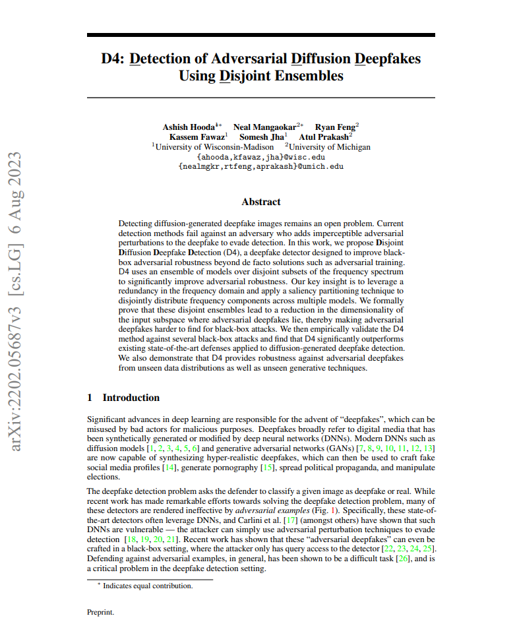
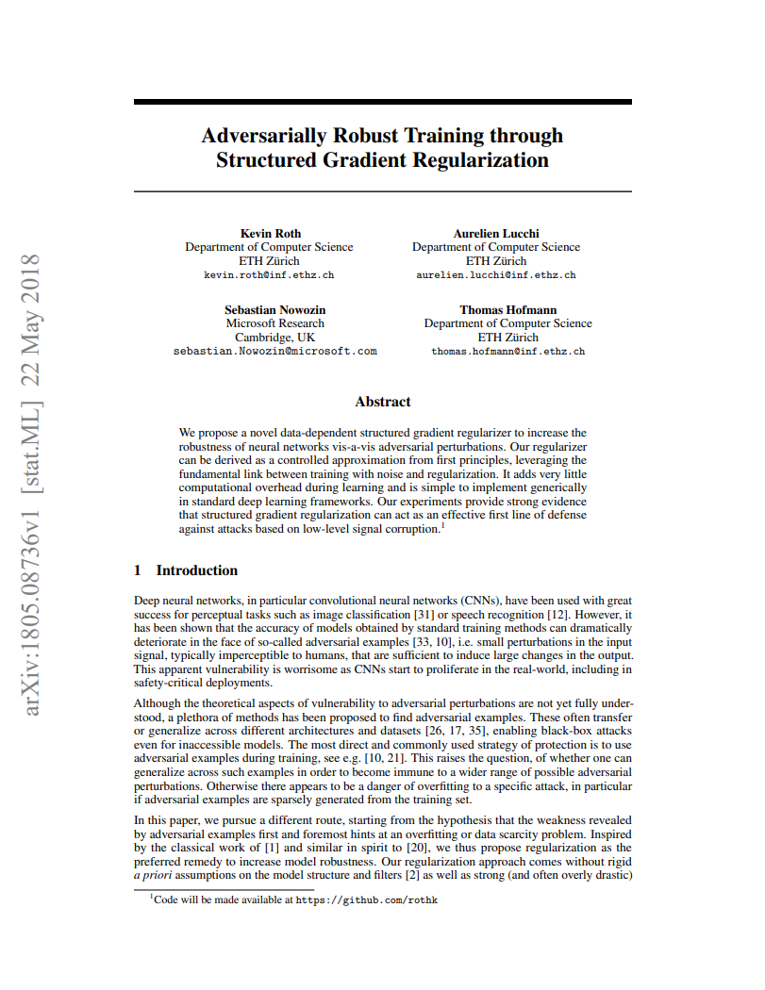
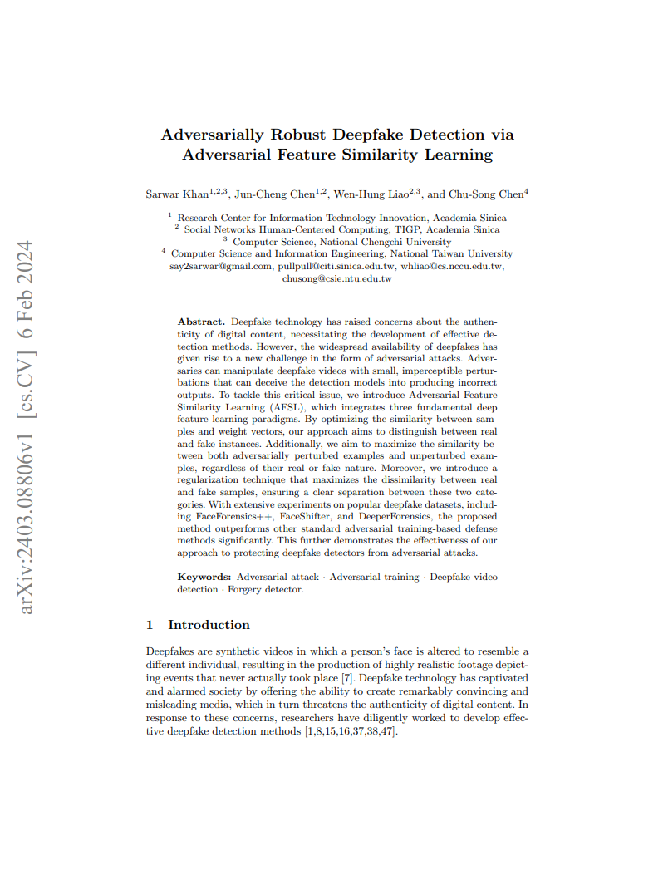
Related WOrks
Many papers published
Some approaches include:
Adversarial Feature Similarity Learning (AFSL)[1]
Adaptive Noise Injection (AdaNI) [2]
Ensemble of CNN Models [3]
Disjoint Ensembles in Frequency Domain (D4) [4]

Slide 6
Outline
Introduction
Related Works
Proposed method
Datasets and Metrics
Experimental results
Conclusion and Future Works
References

Slide 7
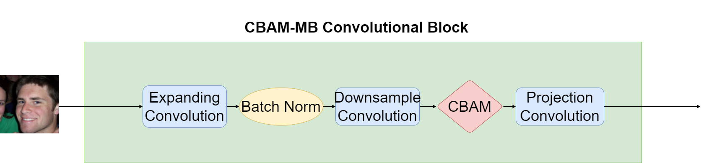
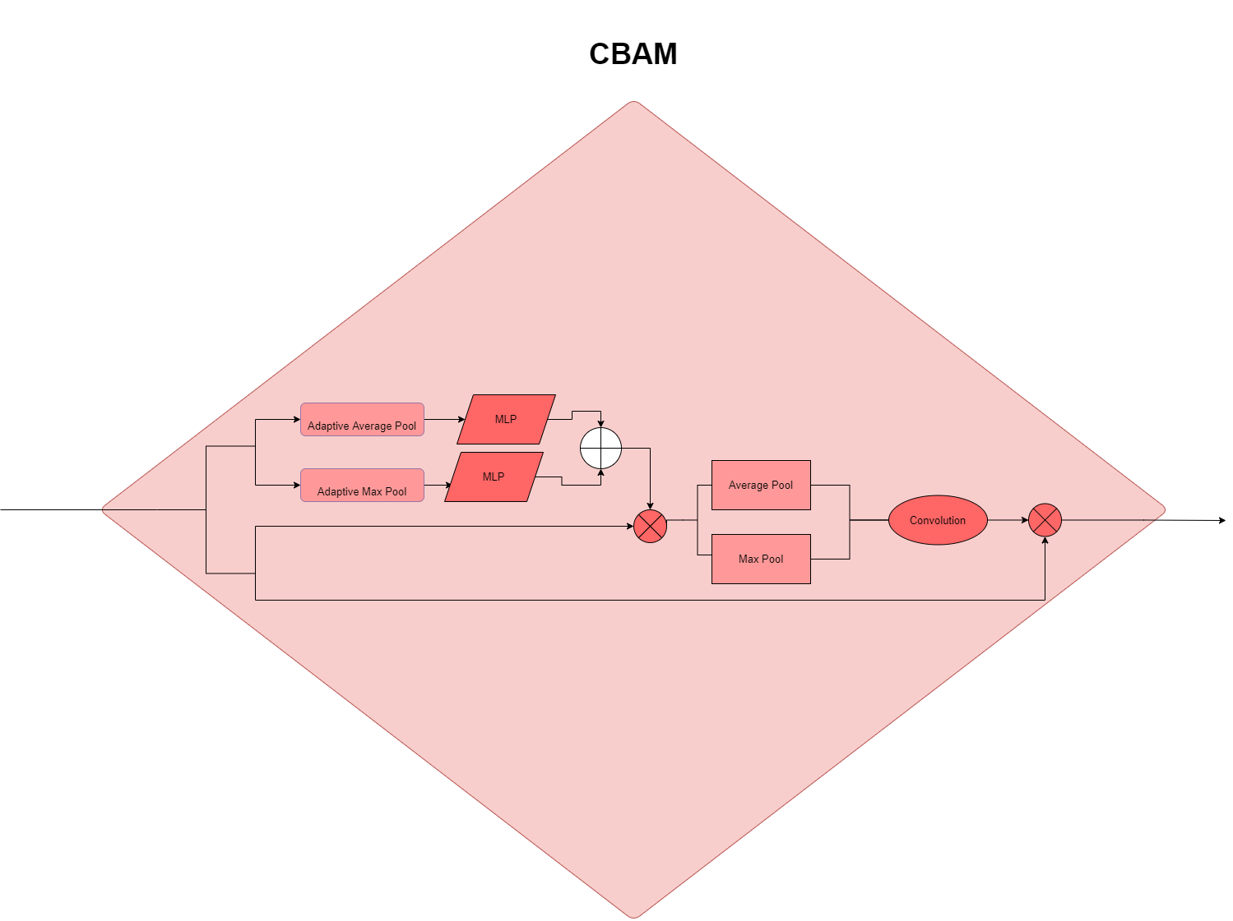
Proposed Method
Aim of the project is choosing an architecture and train it with the gradient regularization loss proposed in [5], which proposes to leverage shallow feature statistics to separate the feature space of the trained model.
The chosen architecture is an EfficientNet-b0 [6] with Convolutional Attention Block Modules (CBAM) [7].

Slide 8
Proposed Method
The EfficientNet-b0 architecture is made up of 9 blocks:
1 Convolutional Layer
7 Mobile Inverted Bottleneck Convolution (MBConv) layers [8]
1 Classification Layer
In the MBConv layers the Squeeze-and-Excitation layers have been swapped with CBAM layers.
The final architecture is made up of 20 layers counting simple Convolutional Layers, Batch Normalization Layers and MBConv Layers.

Slide 9
Outline
Introduction
Related Works
Proposed method
Datasets and Metrics
Experimental results
Conclusion and Future Works
References

Slide 10
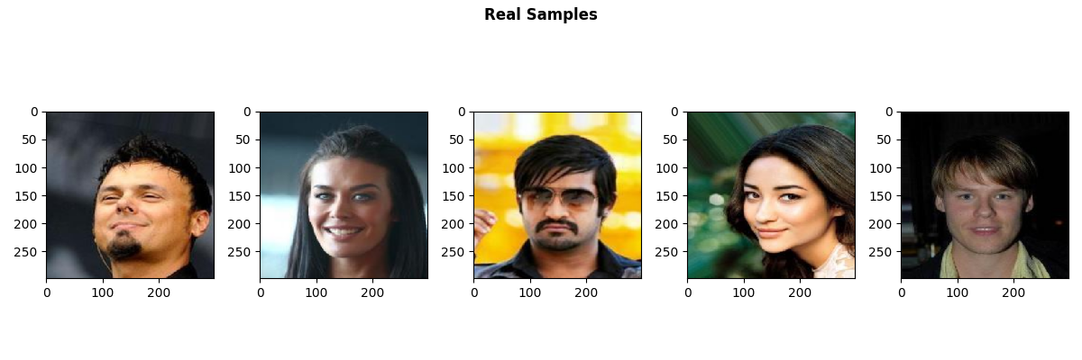
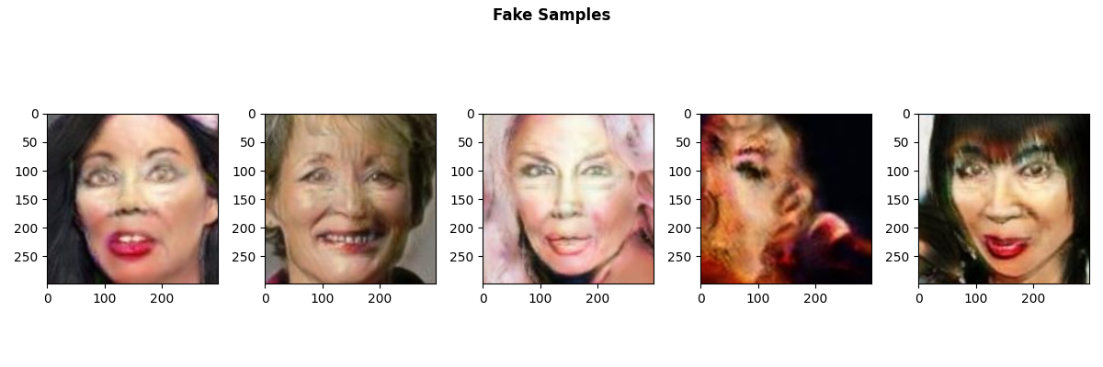
Datasets and Metrics
The Dataset used is a subset of the Diverse Fake Face Dataset (DFFD) [9] available here.
Portion | Training | Validation | Test
Images | 140,000 | 20,000 | 25,000
The subset is extracted randomly from the original and is balanced in training having 70,000 fake images and 70,000 real images. Similarly the validation split is balanced in a 10,000/10,000 split while the test set is split in 20,000/5,000.

Slide 11
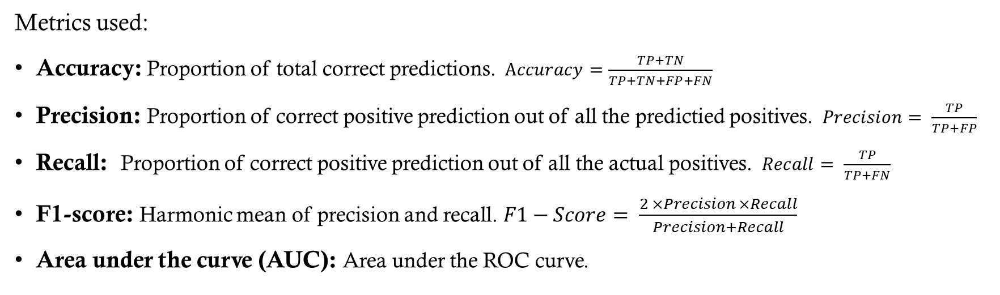
Datasets and metrics
Metrics used:
Accuracy: Proportion of total correct predictions. $Accuracy=\frac{TP+TN}{TP+TN+FP+FN}$
Precision: Proportion of correct positive prediction out of all the predictied positives. $Precision= \frac{TP}{TP+FP}$
Recall: Proportion of correct positive prediction out of all the actual positives. $Recall= \frac{TP}{TP+FN}$
F1-score: Harmonic mean of precision and recall. $F1−Score= \frac{2 ×Precision ×Recall}{Precision+Recall}$
Area under the curve (AUC): Area under the ROC curve.

Slide 12
Outline
Introduction
Related Works
Proposed method
Datasets and Metrics
Experimental results
Conclusion and Future Works
References

Slide 13
Experimental Results
Two models have been trained, a baseline without gradient regularization, and a model with gradient regularization:
Model | Accuracy | Precision | Recall | F1-Score | AUC
Baseline | 99,84% | 99,60% | 99,9% | 99,75% | 99,9%
Regularized | 99,77% | 99,44% | 99,85% | 99,65% | 99,85%

Slide 14
Experimental Results
Three Attacks
The Fast Gradient Sign Method (FGSM)
The Projected Gradient Descent (PGD)
The Patch application

Slide 15
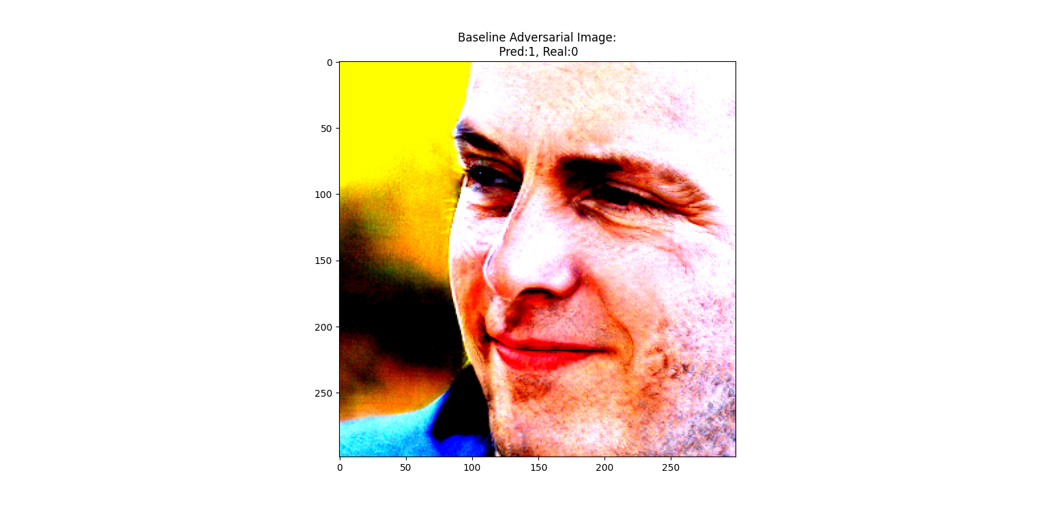
fgsm
A simple, fast, one-step attack that perturbs the input image in the direction that maximally increases the model's loss.
$$x_{adv}​=x+ϵ⋅sign({\text{∇}}_{\text{x}}\text{​}\text{L}\text{(}{\text{f}}_{\text{θ}}\text{​(}\text{x}\text{),}\text{y}\text{))}$$
Computes the gradient of the loss with respect to the input image.
Moves each pixel slightly in the direction of the gradient’s sign.
The magnitude of the perturbation is controlled by a parameter ϵ.

Slide 16

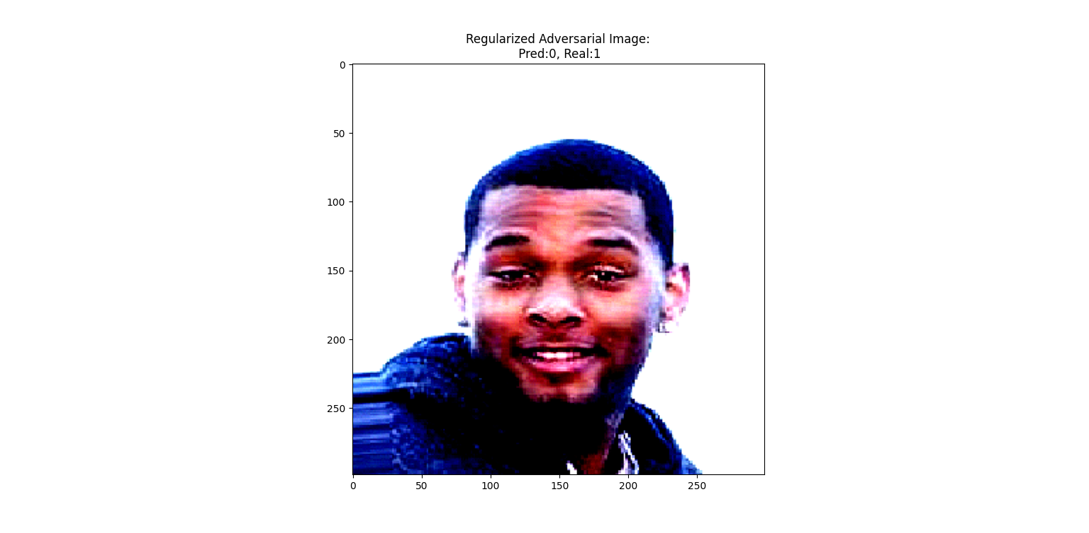
PGD
A stronger, iterative version of FGSM that takes multiple small steps towards increasing the model’s loss, while keeping the perturbation within a predefined bound.
Starts with a small random perturbation within an ϵ-ball around the original image.
Iteratively updates the image using FGSM-like steps.
After each step, projects the perturbed image back into the allowed perturbation region.

Slide 17
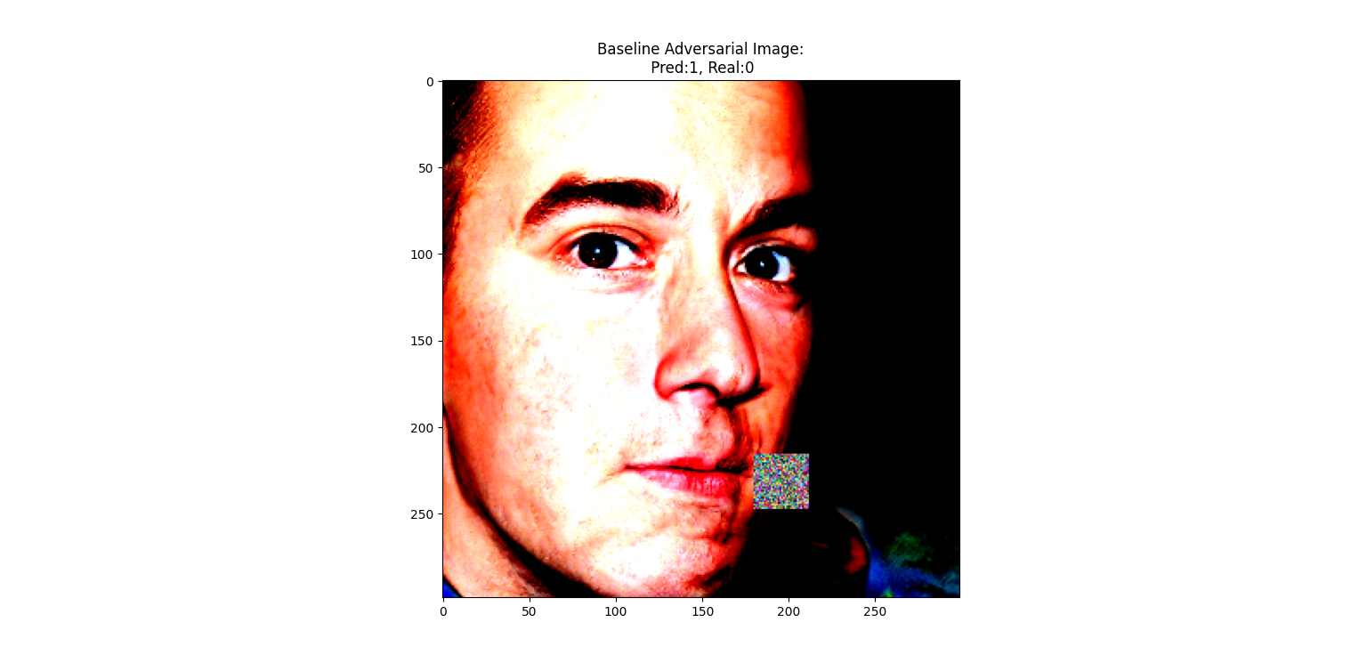
Patch
Simply apply a patch which can be an image or random noise to throw off the model

Slide 18
Experimental Results
The attacks reported the following scores:
Attack | Model | Accuracy | Precision | Recall | F1-Score | AUC
FGSM | Baseline | 93,51% | 87,75% | 95,9% | 90,90% | 95,9%
FGSM | Regularized | 92,83% | 86,85% | 95,12% | 89,99% | 95,12%
PGD | Baseline | 93,13% | 87,22% | 95,68% | 90,42% | 95,68%
PGD | Regularized | 93,24% | 87,38% | 95,78% | 90,57% | 95,78%
Patch | Baseline | 93,54% | 87,80% | 95,96% | 90,95% | 95,96%
Patch | Regularized | 93,52% | 87,77% | 95,95% | 90,92% | 95,95%

Slide 19
Outline
Introduction
Related Works
Proposed method
Datasets and Metrics
Experimental results
Conclusion and Future Works
References

Slide 20
Conclusions and future works
The experiments, tested on different seeds, have shown that there is no real improvement in robustness by applying the gradient regularization.
Future works may consider simplier models, possibly without attention mechanisms, to check if the gradient regularization is actually capable of improving robustness.

Slide 21
Outline
Introduction
Related Works
Proposed method
Datasets and Metrics
Experimental results
Conclusion and Future Works
References

Slide 22
Refrences
[1] Khan, S., Chen, J. C., Liao, W. H., & Chen, C. S. (2024, January). Adversarially robust Deepfake detection via adversarial feature similarity learning. In International conference on multimedia modeling (pp. 503-516). Cham: Springer Nature Switzerland.
[2] Li, Y., Zhang, C., Qi, H., & Lyu, S. (2024). AdaNI: Adaptive Noise Injection to improve adversarial robustness. Computer Vision and Image Understanding, 238, 103855.
[3] Khan, S. A., Artusi, A., & Dai, H. (2021). Adversarially robust deepfake media detection using fused convolutional neural network predictions. arXiv preprint arXiv:2102.05950.
[4] Hooda, A., Mangaokar, N., Feng, R., Fawaz, K., Jha, S., & Prakash, A. (2024). D4: Detection of adversarial diffusion deepfakes using disjoint ensembles. In Proceedings of the IEEE/CVF Winter Conference on Applications of Computer Vision (pp. 3812-3822).
[5] W. Guan, W. Wang, J. Dong and B. Peng, "Improving Generalization of Deepfake Detectors by Imposing Gradient Regularization," in IEEE Transactions on Information Forensics and Security, vol. 19, pp. 5345-5356, 2024
[6] M. Tan and Q. Le, (2019). EfficientNet: Rethinking model scaling for convolutional neural networks. In Proc. Int. Conf. Mach. Learn., pp. 6105–6114.
[7] Woo, S., Park, J., Lee, J. Y., & Kweon, I. S. (2018). Cbam: Convolutional block attention module. In Proceedings of the European conference on computer vision (ECCV) (pp. 3-19).
[8] Sandler, M., Howard, A., Zhu, M., Zhmoginov, A., & Chen, L. C. (2018). Mobilenetv2: Inverted residuals and linear bottlenecks. In Proceedings of the IEEE conference on computer vision and pattern recognition (pp. 4510-4520).
[9] Dang, H., Liu, F., Stehouwer, J., Liu, X., & Jain, A. K. (2020). On the detection of digital face manipulation. In Proceedings of the IEEE/CVF Conference on Computer Vision and Pattern recognition (pp. 5781-5790).

Slide 23
Thank you!
Any question?

